Slide 1
Smart Knee
Brace
Low Wai Kent
Kenneth Rithvik
Chokkalingam Shanmugasiva
1

Slide 2
Smart Knee Brace
Traditional Knee Brace
Monitor Gait Movement
Limiting potentially harmful knee movements while rehabilitating after recent knee surgery or an injury
Protection
Protect a reconstructed or repaired ligament and allow early motion of the knee joint.
Smart Knee Brace
All the Above Plus +
ML based movement recognition and monitoring
Motion Capture using IMU
24*7 Remote Monitoring Aiding Tele Health Care
2

Slide 3


Project Time Line
2017
2017
Today
Mar 2018
Apr 2018
June 2018
Feature List of Product
Wireless Motion Capture
Tele health monitor
Knee Flex measurement
Motion capture and 3D simulation
Milestone | Achievement | Status
1 | Get Gyro meter and Accelerometer readings from knee brace prototype using mobile phone sensors | Done
2 | Create prototype-two with wireless motion capture capability using IMU and on knee processor | Done
3 | Create a secure architecture for receiving and logging different sensor data from smart knee (IMU + On knee processor) | Done

Slide 4
Literature Review
Real-time Gesture Pattern Classification with IMU Data
stanford.edu/class/ee267/Spring2017/report_fu_yu.pdf
The user can hold the arduino chip in his/her hand and perform any hand gesture patterns. The project included collecting training and testing data, extracting features from IMU inputs, building classifier models and visualization.
IMU-Based (Knee) Joint Angle Measurement
Sensors 2014, 14, 6891-6909
The research make use of the fact that the knee joint behaves approximately like a mechanical hinge joint. Only angular rates and accelerations are used to obtain the position and the direction vector of the knee ﬂexion/extension axis.

Slide 5
Our Target Users
Literature Review
Post Knee-Surgery Patients
North American Journal of Sports Physical Therapy – Volume 04-2009
Understanding the importance of symmetrical range-of-motion (ROM) of the knee after surgery is the most important factor in the rehabilitation process. The ROM measurements are a central issue in the rehabilitation of a patient after surgery.
Training of Parachutist
Occupational Medicine Vol. 49, 17-26, 1999
The British developed an alternative landing roll in which the parachutist landed with their feet and knees together and conducted a sideways roll successively onto outer side of the leg, thigh, buttocks, across the back and onto the opposite shoulder. This technique caused significantly fewer injuries than the first forward landing roll and was adopted by the US.

Slide 6
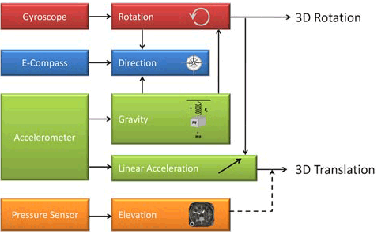
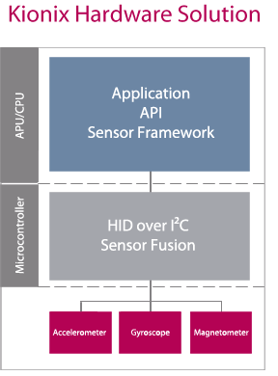
Sensor Fusion

Slide 7
Sensor Fusion
Sensor fusion solves key motion sensing performance issues of 6-axis modules consisting of a 3-axis accelerometer and a 3-axis gyroscope or a 3-axis accelerometer and a 3-axis magnetic sensor.
A 6-axis inertial module with an accelerometer and a gyroscope loses its absolute orientation as the gyro drifts over time, requiring calibration to restore accurate heading reference.
A 6-axis module with accelerometer and magnetometer is prone to data corruption in the presence of ferrous materials in the environment.
A 9-axis module with an accelerometer, a gyroscope and a magnetometer eliminates the drift that occurs with stand-alone sensor solutions. But these can be subject to magnetic interference. Algorithms to fuse the sensor data are required to compensate for the magnetic interference.
The purpose of sensor fusion is to take each sensor measurement data as input and then apply digital filtering algorithms to compensate each other and output accurate and responsive dynamic attitude (pitch/roll/yaw) results.

Slide 8
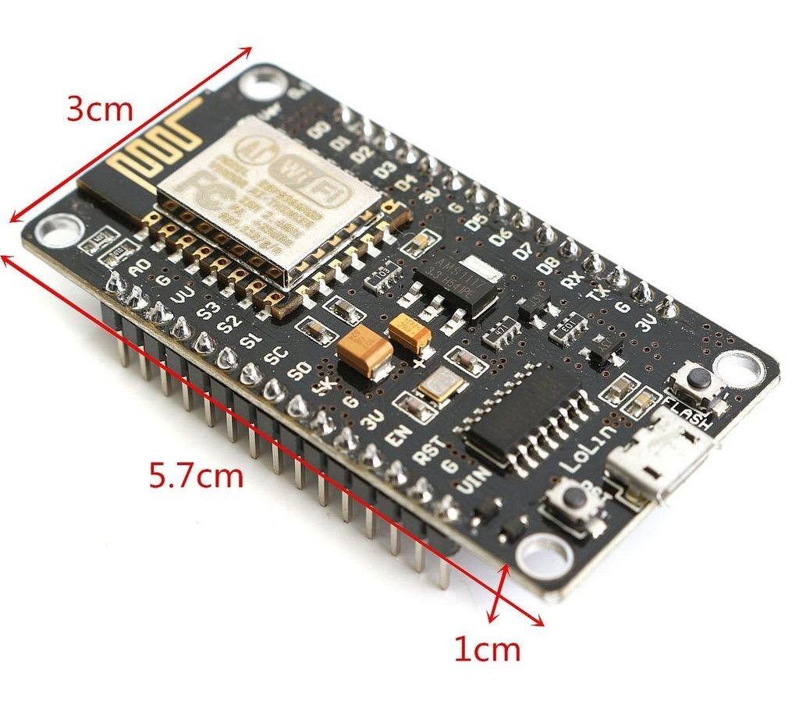
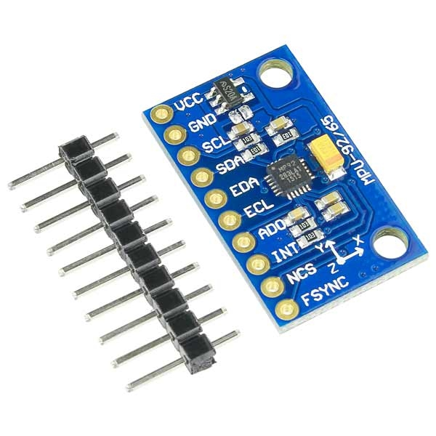
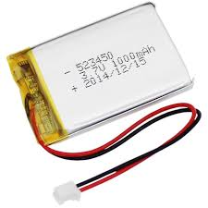
Hardware
MPU9250
Nodemcu ESP8266
3.7V Lithium-Ion Battery

Slide 9
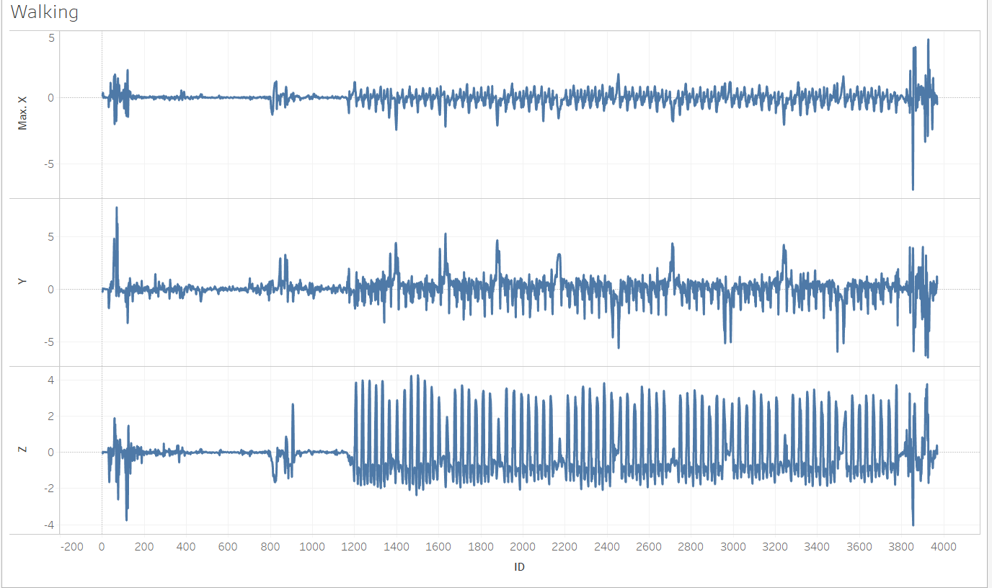
EDA

Slide 10
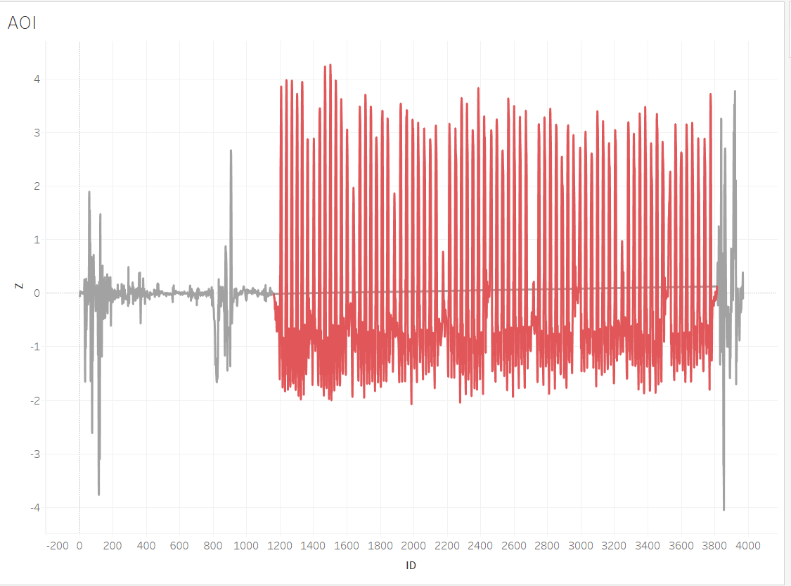
Pattern of Interest

Slide 11
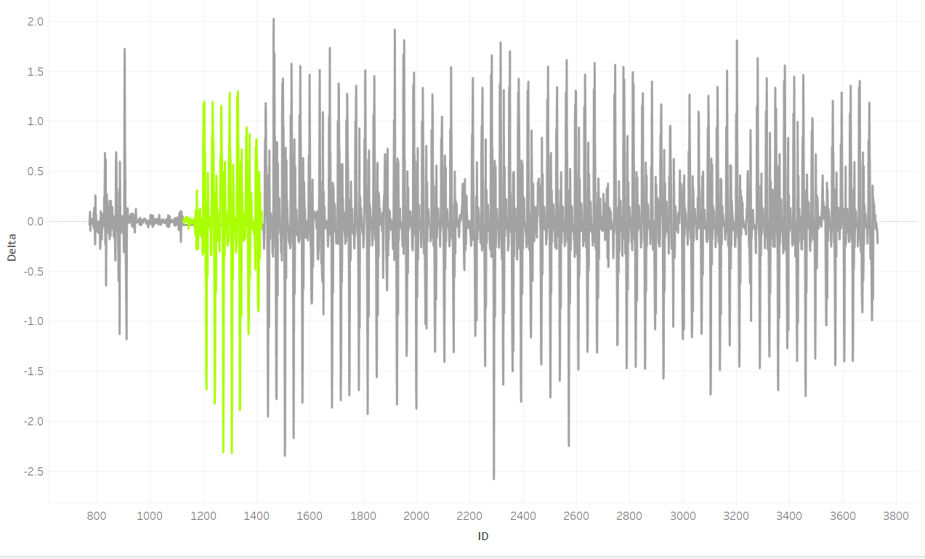
Step Pattern

Slide 12
THANK YOU

Slide 13
Reference
AHRS algorithm
‘DCM filter‘
http://ieeexplore.ieee.org/document/5695918/
http://ieeexplore.ieee.org/document/4913055/
13

